Slide 1
Elevate SPFX solution with Custom Web API

Slide 2

Speaker Introduction
C# Corner MVP, MCP, MCTS,MCSA, OCA
http://manojmittalblogs.blogspot.in
https://www.youtube.com/user/manojmcans/videos
/Manojmcans
In/manoj-mittal-mcp-mcts-oca-mcsa/
https://www.c-sharpcorner.com/members/manoj-mittal
Manoj Mittal
Technical Architect
@ Mindtree Ltd
Manoj Mittal
Technical Architect
@ Mindtree Ltd

Slide 3

Agenda
SharePoint Development Journey
Why and What SPFX
Development Tool Chain
SPFX and Web API Solution
Execute SPFX solution with SharePoint App Principal

Slide 4
SharePoint Development Model - Journey
SP 2003
SP 2007
SP 2010
SP 2013 & Online
SP 2013 & Injection
Build on .NET Framework 2.0
Server Side API
Full Trust Code
Manual Deployment
Based on WSS 3.0
Server Side API
Full Trust Code
Features (New)
Deployment Solution and Packages
SharePoint Foundation
Sandbox Solution
Full Trust Code
Client Side API (CSOM)
SharePoint Foundation
Client Side API (CSOM)
Add-In
Provided Hosted
SharePoint Hosted
Java Script Injection
CEWP
SEWP
Customization
Brittle
Not Easy
Blocked

Slide 5
Why SPFX
Provide full support for client side customization
Provide easy access to SharePoint data
Customization run in current context
Customization is responsive and accessible
Development experience embrace the Web Stack Development
Customization work in Classic and Modern Pages
Scoped to Tenant
Limited to creating Client Side Web parts
Only way to customize the Modern Pages

Slide 6
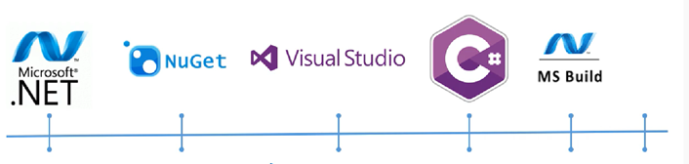
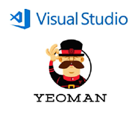



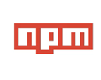

Development Toolchain Comparison
Local JavaScript run time engine
Package and Dependency Management
Web Pack
Generator Framework – provide scaffolding.
VS Code – Dev and debug tool
Open Source Programing Language and Superset of JS, like Class, interface, extends etc.
Automate the repetitive task, to packaging and deployment

Slide 7
Focus on What you need to know
Get familiar with
NPM
Type Script
Just Install and Forget about
Node js
Yeoman
Gulp
Web Pack

Slide 8
Focused Command
Gulp Serve (It used to run the solution locally workbench)
Workbench:- SharePoint Workbench is a developer design surface that enables you to quickly preview and test web parts without deploying them in SharePoint
Gulp Build (It transpile all SCCS and TS file into necessary CSS and JS files)
Folder Name
lib
Temp
Gulp Bundle (bundle all js file and manifest file)
Folder Name
dst
Gulp Package –solution (Convert into deployable solution + .sppkg)
Folder Name
SharePoint -> Solution

Slide 9

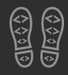

Slide 10
Call to action
Share your feedback on Bootcamp at https://aka.ms/o365devbootcampfeedback
Join Office 365 developer program https://dev.office.com/devprogram to leverage all resources for Office 365 development learning
Build applications on Office 365 platform
Attend MVP led local community events to continue learning on Office 365 development

